Slide 1





SC 19 Tutorial: Getting Started with Containers on HPC
Shane Canon¹, Sameer Shende², Carlos Eduardo Arango³ , Andrew J. Younge⁴
¹Lawrence Berkeley National Lab scanon@lbl.gov | ²University of Oregon sameer@cs.uoregon.edu
³Sylabs Inc eduardo@sylabs.io | ⁴Sandia National Labs ajyoung@sandia.gov

Slide 2
Outline
13:30 – 13:45 Introduction to Containers in HPC (Younge)
13:45 – 14:15 How to build your first Docker container (Canon)
14:15 – 14:45 How to deploy a container on a supercomputer (Canon)
14:45 – 15:00 Best Practices (Canon)
15:00 – 15:30 -- Break –
15:30 – 16:00 Running an HPC app on the E4S container (Shende)
16:00 - 16:30 How to build a Singularity container image (Arango)
16:30 - 16:50 Running Singularity on a supercomputer & adv features (Arango)
16:50 - 17:00 Success Stories & Summary (Canon)
Link: https://tinyurl.com/yxbhpo35

Slide 3
Success Stories & Summary

Slide 4
Stats on Shifter Use at NERSC
10M+ Image Lookups
1900+ Unique Image tags
700+ Unique Users
Still a small fraction of NERSC overall use (~3%)

Slide 5
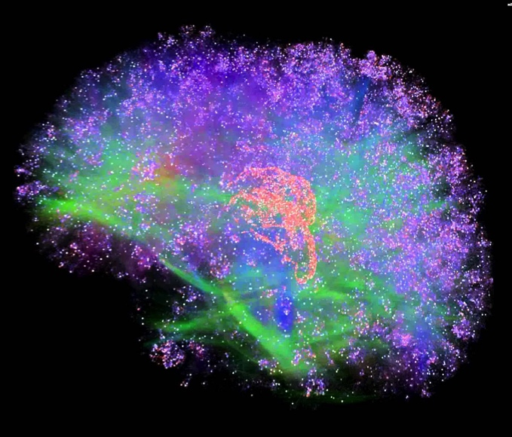
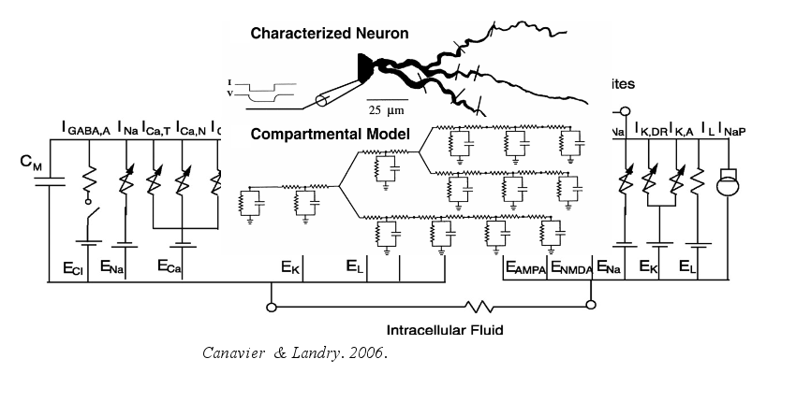
Modeling the Mind
Neuron
Simulation program to model neuron response to stimuli
Simulation: 3000 points by 4000 time steps for 400 neurons
Why Containers?
Software developed in 1985, many older dependencies (32-bit)

Slide 6
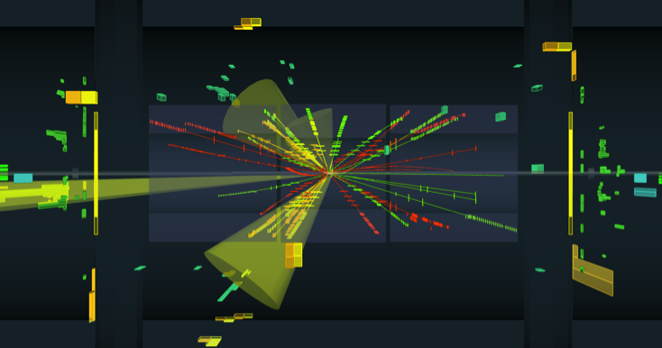

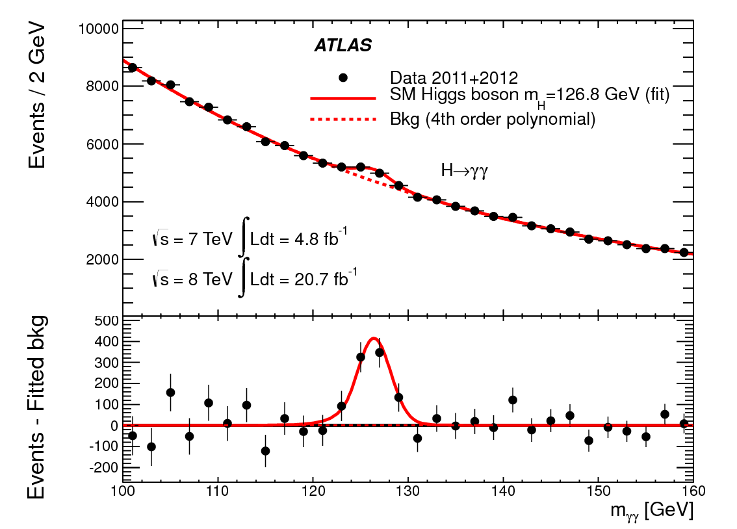
Probing the Fundamentals of Matter
Large Hadron Collider (LHC)
300 trillion proton-proton collisions and 30 PBs of data per year.
Data analysis, simulation, multi-site data and computing pool
Why Shifter?
Complicated software stack: Needs FUSE and elevated permissions to run
Integrated framework for running with images at all computing sites

Slide 7
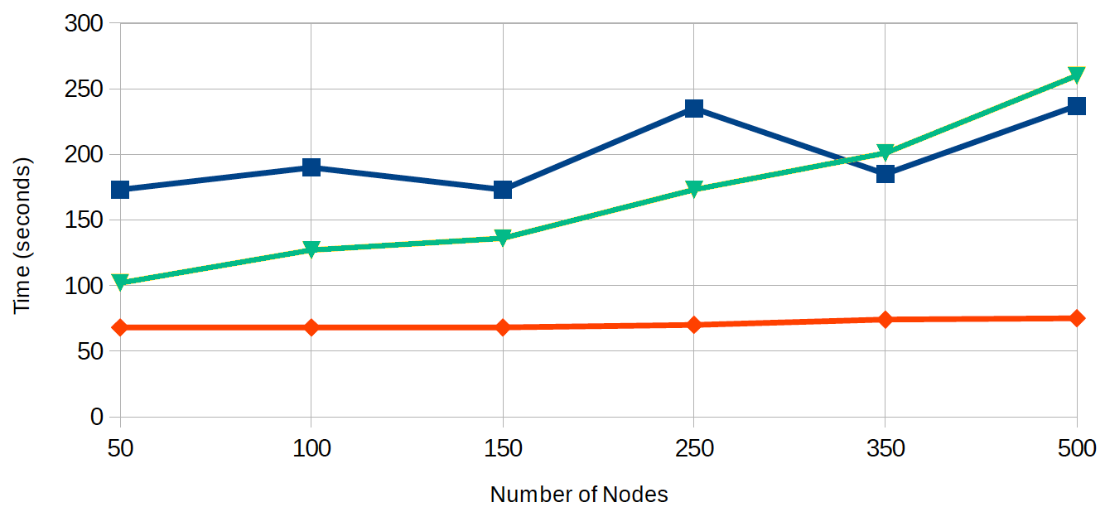
Creating a Monster
The software stack is very big: 3.5 TB and 20M inodes
Compress and de-duplicate with squashfs: 350 GB
Start up time shows excellent scaling out to 500 nodes (16,000 cores)
Burst Buffer
Lustre
Shifter

Slide 8
Joint Genome Institute
Production sequencing center for DOE
Sequencing microbial, microbial communities, plant and fungal organisms
Why Containers?
Complex workflows utilizing dozens of tools for a single pipeline
Reproducibility and portability is critical
Container workflow tools (Cromwell) being used to encapsulate entire workflows

Slide 9
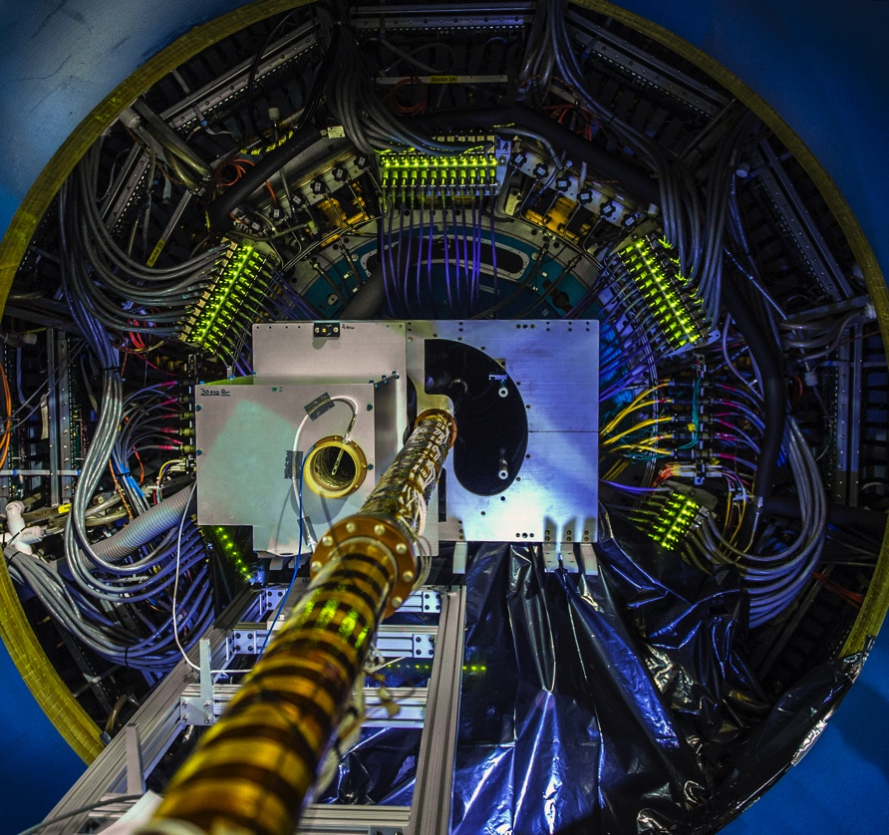
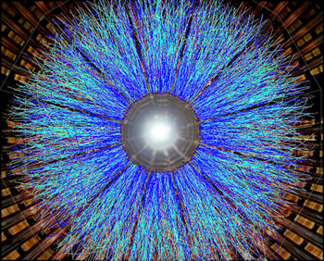
Probing The Nucleus
STAR at Brookhaven, NY
smashing nuclei into each other to understand their component parts
Data analysis and simulation
Why Containers?
Difficult software dependencies (32-bit libraries)

Slide 10

Containers at scale
GHz | SINGLE DAY MAPS |  | FULL SEASON MAPS
 | TEMPERATURE | POLARIZATION | TEMPERATURE | POLARIZATION
20
30
40
95
150
220
270
Measuring the Composition of the Universe
CMB – S4 - Ambitious collection of telescopes to measure the remnants of the Big Bang with unprecedented precision
Simulated 50,000 instances of telescope using 600,000 cores on Cori KNL nodes.
Why Shifter and Containers
Python wrapped code needs to start at scale
Without Shifter application timed out during startup
Uses Intel Compilers
Courtesy of Ted Kisner

Slide 11
Summary
Thanks for your attendance and attention
AWS Instances will be shutdown shortly
NERSC Training accounts are active through the remainder of the day
Please use the Google Doc or Slack to ask additional questions

Slide 12
Other SC activities
CANOPIE-HPC Workshop
Time: Monday 2:30 PM – 5:00 PM
Location: Rm 704-706
HPC Containers BOF
Time: Wednesday 5:15 PM – 6:45 PM
Location: Rm 401-402-403-404

Slide 13
Questions?
Next: learn how to work with your first container!

Slide 14

Spark
“Big Data” high productivity analytics Framework
Designed around commodity clusters (Ethernet network and local disk)
Shifter image: lgerhardt/spark-1.6.0
Uses per-Node write cache for spills and other temporary per-node file caches.
Tested up to full scale of Cori Phase 1 (1600 nodes) with multiple Spark applications.

